Slide 1


NATIONAL INSTITUTE OF TECHNOLOGY ANDHRA PRADESH
Department of Electrical and Electronics engineering
A Minor project on
Handwritten Digit Recognition
Name - Suraj Kumar
Roll No. - 521247
SEC - B
lll B.Tech EEE

Slide 2

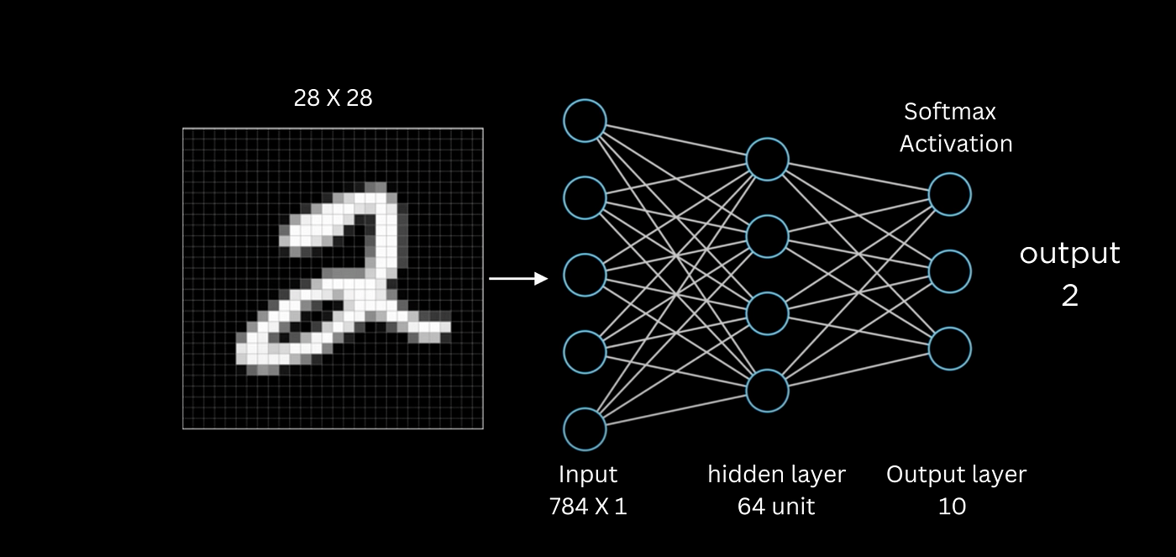
Introduction to Handwritten Digit Recognition
Explored the fascinating field of handwritten digit recognition using the renowned MNIST dataset. And learnt how machine learning models can accurately identify the numeric digits 0-9 from handwritten samples, enabling powerful applications in data entry, document processing, and more.

Slide 3


Overview of the MNIST Dataset
Handwritten Digits
Diverse Data
The MNIST dataset contains 70,000 images of handwritten digits from (0 to 9) , providing a benchmark for image classification tasks.
The dataset includes a wide variety of handwriting styles, making it a challenging and realistic test case for machine learning models.
Structured Format
The images are grayscale, 28x28 pixels in size, and stored in a well-organized, easy-to-use format.

Slide 4


Data Preprocessing: Normalization
To prepare the MNIST dataset for training, we first need to normalize the pixel values. This is done by dividing each pixel value by 255, effectively scaling the pixel intensities to the range [0, 1].
Rescale Pixel Values: The raw MNIST dataset contains pixel values ranging from 0 to 255. We rescale these values to the range [0, 1] by dividing each pixel by 255.
Normalize Pixel Intensities: Normalizing the pixel values helps the neural network learn more effectively, as it reduces the dynamic range of the input features.
Improve Model Convergence: Normalization is a common preprocessing step that can improve the model's ability to converge during training, leading to better performance on the handwritten digit recognition task.

Slide 5


Neural Network Architecture
The neural network model for our handwritten digit recognition task consists of a deep, multilayer architecture. The input layer takes in the 28x28 pixel grayscale images, followed by several convolutional and pooling layers to extract high-level features.
These are then fed into dense, fully-connected layers that learn complex representations and classify the digits. Regularization techniques like dropout are employed to prevent overfitting and ensure robust performance on new, unseen data.

Slide 6
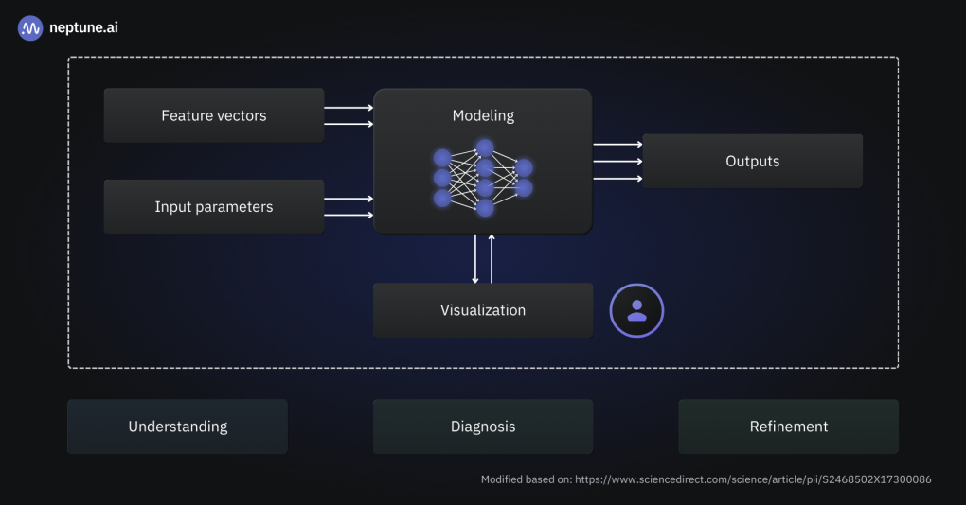
Model Compilation and Training
1
Compile the Model
Define the model's loss function, optimizer, and evaluation metrics. This sets up the training process to maximize performance.
2
Prepare the Data
Split the dataset into training and validation sets. Ensure the data is properly formatted and normalized for efficient model training.
3
Train the Model
Fit the model to the training data, monitoring validation performance to avoid overfitting. Adjust hyperparameters as needed to improve results.

Slide 7
Evaluation Metrics: Accuracy, Confusion Matrix
1
Accuracy
2
Confusion Matrix
The primary metric for evaluating the model's performance is accuracy - the percentage of correct predictions out of the total number of predictions.
The confusion matrix provides a detailed breakdown of the model's performance, showing the number of true positives, true negatives, false positives, and false negatives for each digit class.
3
Visualizing Confusion Matrix
4
Identifying Model Weaknesses
By visualizing the confusion matrix using a heatmap, you can quickly identify the digit classes that the model is struggling with and focus on improving its performance on those specific classes.
The confusion matrix helps pinpoint the model's weaknesses, allowing you to target specific areas for improvement during the training and fine-tuning process.

Slide 8
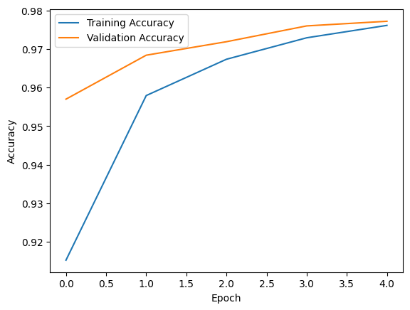
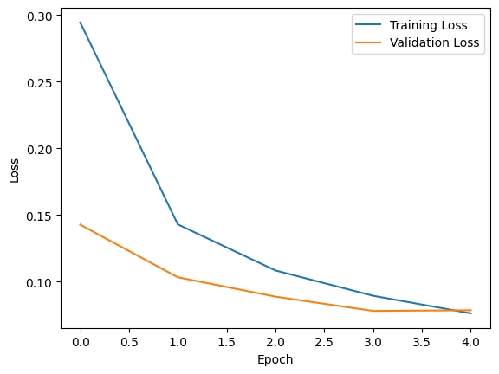
Graphical Plot of Accuracy/loss vs Epochs :
Training and Validation Accuracy:
- Accuracy measures how often the model's predictions match the actual labels.
- If both lines are increasing and close together, it suggests that the model is learning well and not overfitting. If the training accuracy is significantly higher than the validation accuracy, it might indicate overfitting.
Training and Validation Loss:
- It explain that loss represents how well the model is performing its task, with lower values indicating better performance.
- Similar to accuracy, training loss (blue line) measures the error on the training data during training, while validation loss (orange line) reflects the error on unseen data.

Slide 9
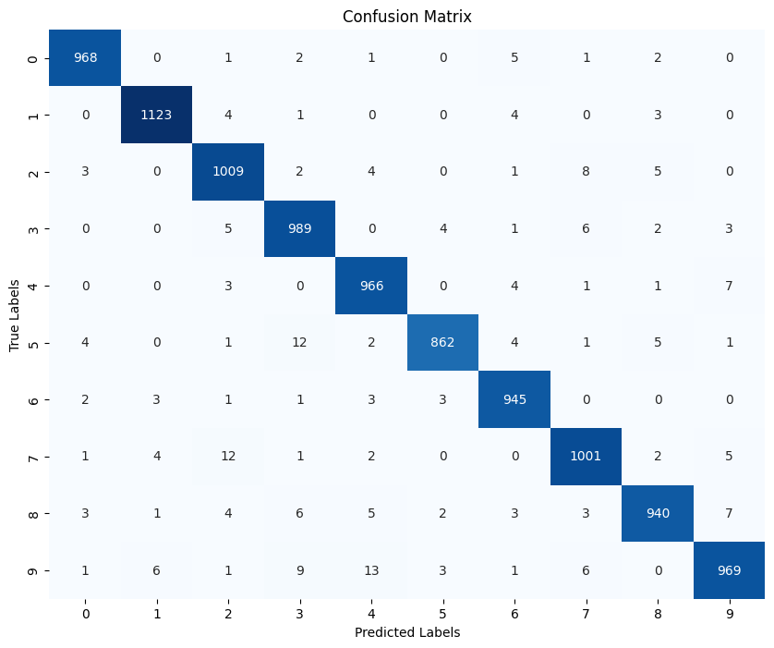
Visualization of Predicted vs. Actual Labels
To visualize the model's performance, we can create a confusion matrix that compares the predicted labels with the true labels from the test dataset. This allows us to identify where the model is making mistakes and understand its overall accuracy across different digit classes.

Slide 10




Improving Model Performance
Optimize Hyperparameters
Tune model hyperparameters like learning rate, batch size, and epochs to find the best configuration for improved accuracy.
Augment the Dataset
Apply data augmentation techniques like rotation, scaling, and flipping to increase the diversity of the training data.
Deeper Network Architecture
Experiment with deeper neural network architectures to capture more complex features and patterns in the handwritten digit data.

Slide 11




Deployment and Real-world Applications
Model Deployment
Mobile Apps
Document Processing
Financial Services
The model can be integrated into mobile apps, allowing users to input handwritten digits and get instant recognition results.
Banks and financial institutions can utilize this technology for processing checks, invoices, and other financial documents with handwritten digits.
Once the model is trained, it can be deployed to production environments, enabling real-time handwritten digit recognition in various applications.
Handwritten digit recognition can be used in document processing, such as automated data entry and form filling.

Slide 12

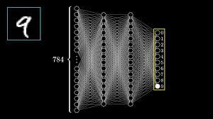
Conclusion and Key Takeaways
In conclusion, the handwritten digit recognition project using the MNIST dataset has demonstrated the power of deep learning techniques in tackling complex pattern recognition tasks. By building a robust neural network architecture and carefully preprocessing the data, we have achieved high accuracy in classifying handwritten digits.
The key takeaways from this project include the importance of data normalization, the flexibility and scalability of neural networks, and the value of evaluating model performance using metrics like accuracy and confusion matrices. The visual representations of predicted versus actual labels provide valuable insights into the model's strengths and areas for improvement.
Looking ahead, this project lays the foundation for exploring more advanced techniques, such as transfer learning or ensemble methods, to further enhance the model's performance. Additionally, the deployment of this model in real-world applications, such as document digitization or mobile banking, presents exciting opportunities to make a tangible impact.

